Slide 1
This Email Could Have Been a Meeting
Debbie Ginsberg dginsberg@law.Harvard.edu

Slide 2
Email problem

Slide 3
Too many emails

Slide 4
Not enough time

Slide 5
Prioritizing

Slide 6
Missing important info

Slide 7
Back in control

Slide 8
Triage immediately! Daily?
Archive
Respond
Delegate
Schedule

Slide 9
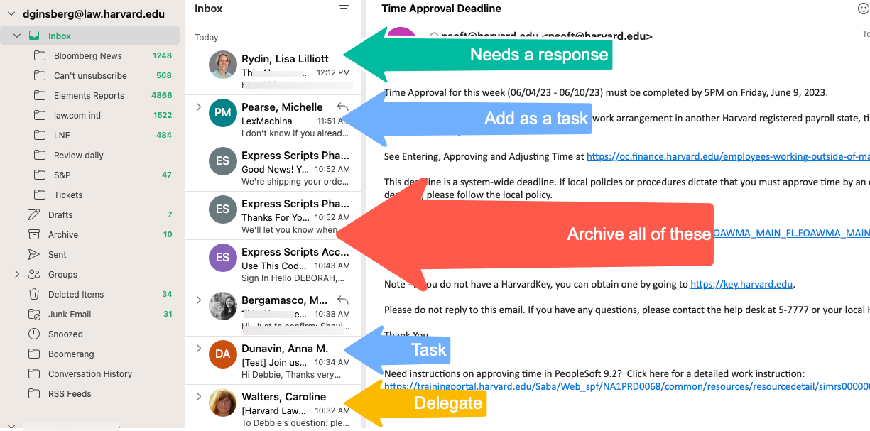

Slide 10
Email tools
Set Goals
Email Audit

Slide 11
What do you want?
Inbox Zero?
More control?
Something else?

Slide 12
Email tools
Unsubscribe
Tags/Rules
Calendar

Slide 13
AOL

Slide 14
Too important to miss!

Slide 15
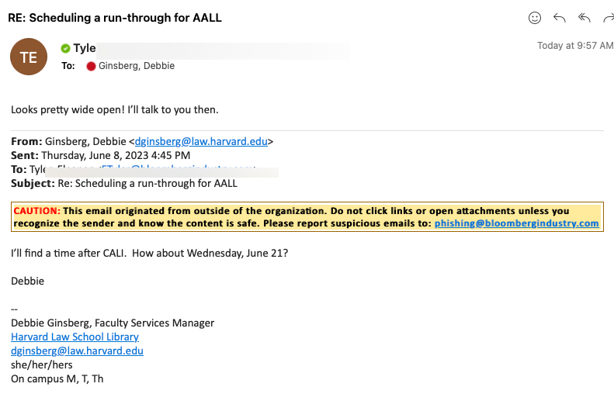
Don’t reply, schedule

Slide 16
Email tools
SaneLater/Unroll.me
ActiveInbox/ToDo/Asana
Added: Look at the ToS for these – they can have privacy issues esp. the free versions

Slide 17
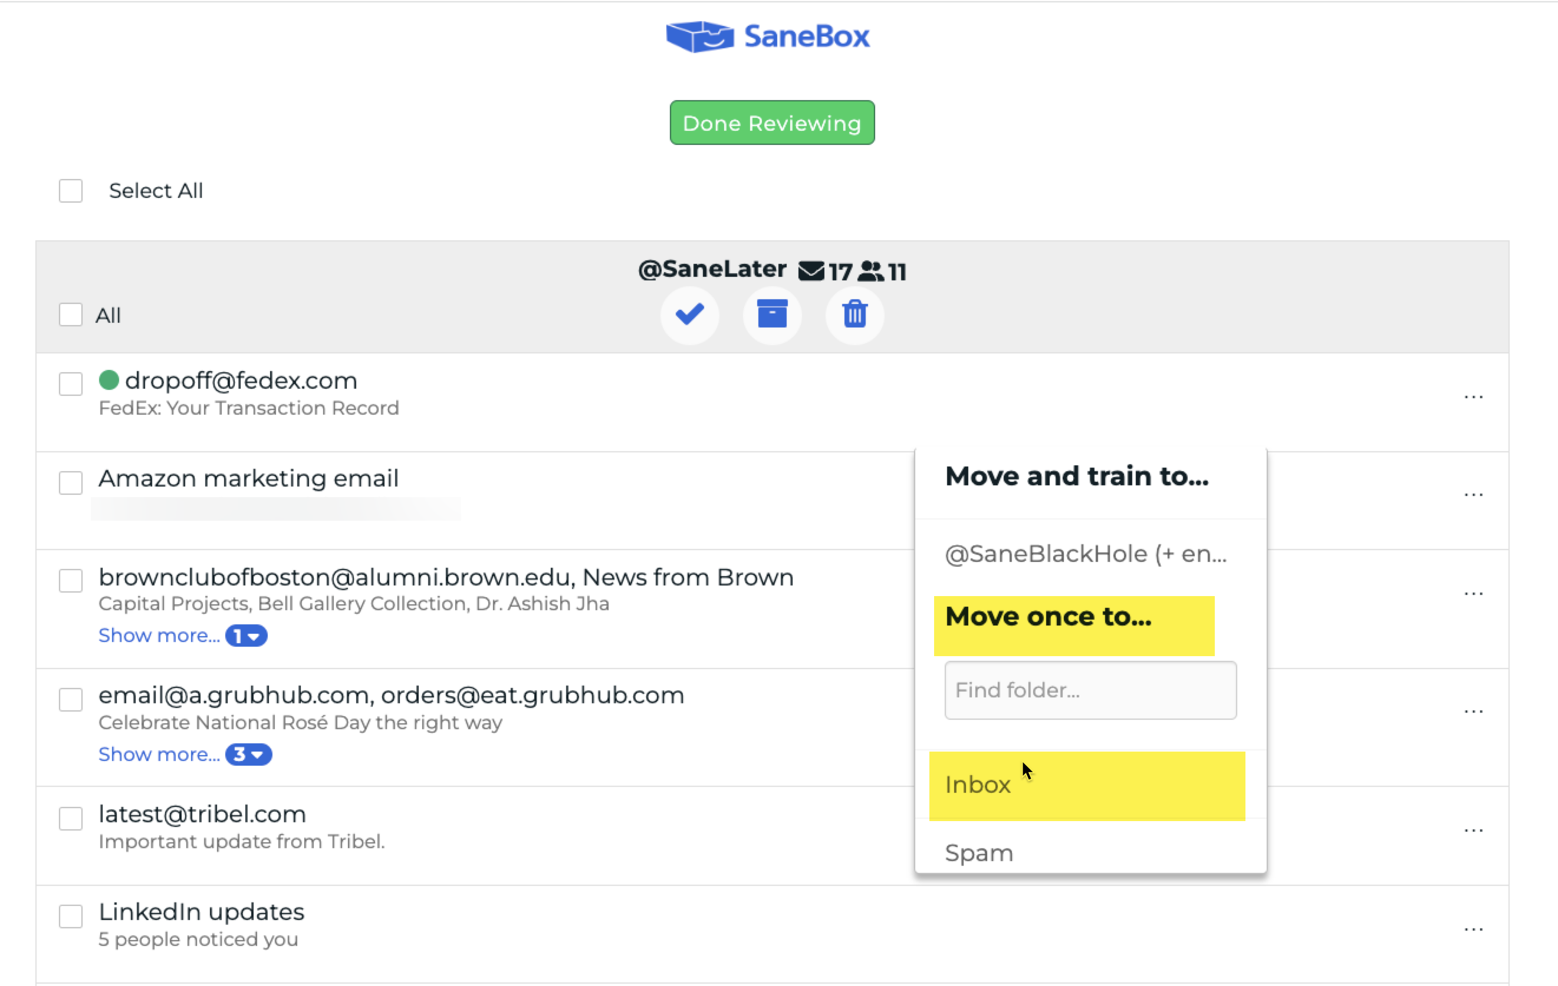
Unsubscribe Light [SaneLater]

Slide 18
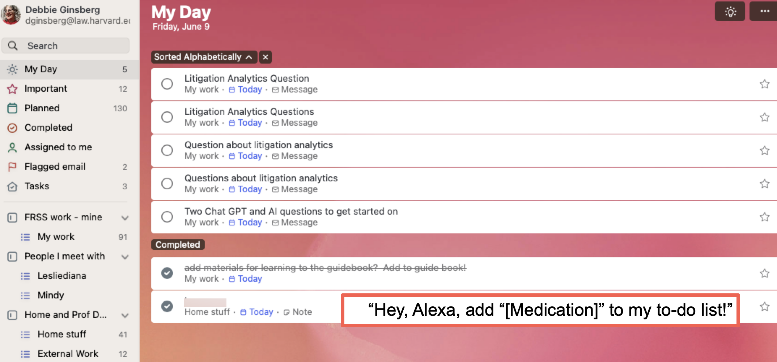
Set and Forget [ToDo]

Slide 19
Your time
Do you have to be on all the time?
Pause inbox
Schedule responses

Slide 20
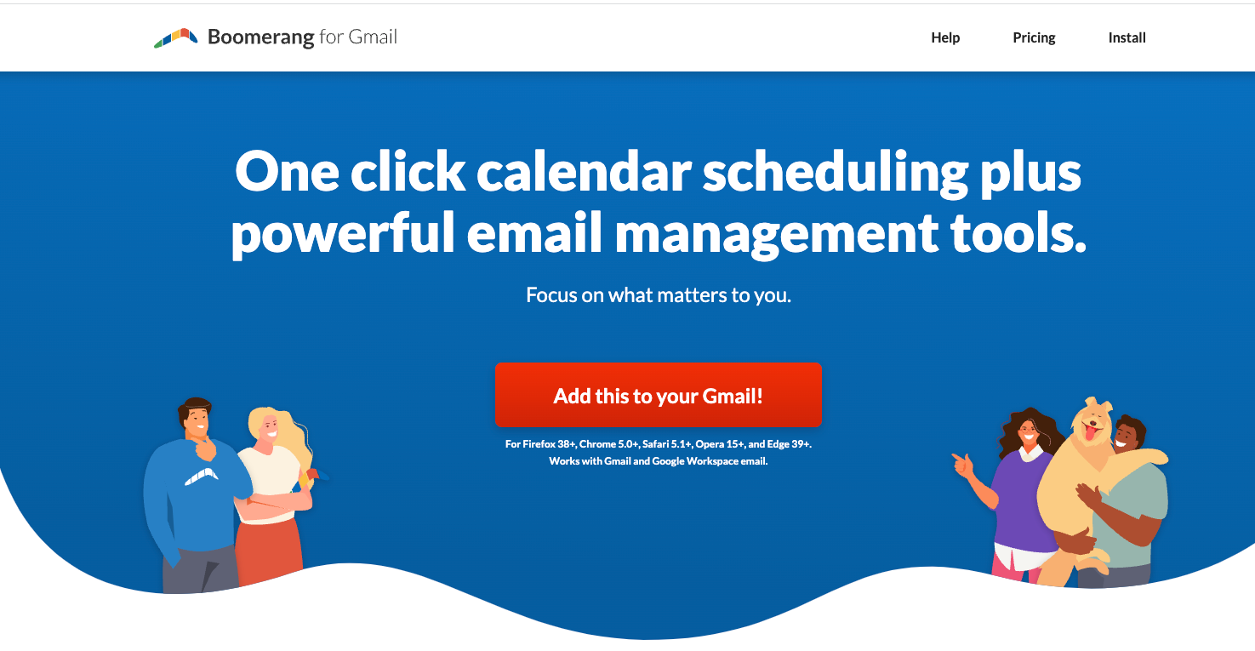

Slide 21
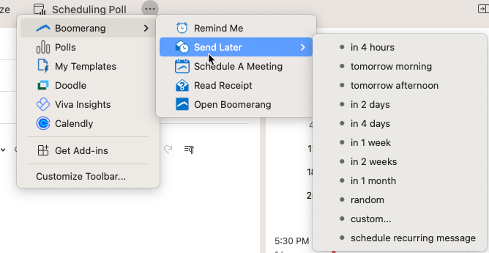
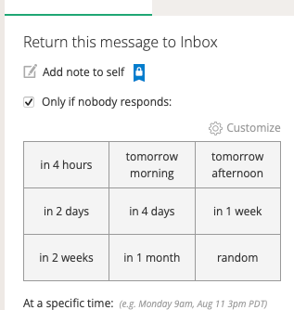
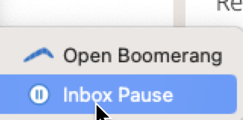

Slide 22
You time
Remove email/IM app
Turn off notifications

Slide 23
Where should we talk?
IM/Slack
Zoom
God forbid- the phone!

Slide 24
The right tool for the right job
Instant Message (GChat, Slack, Teams)
Quick message or question
Need a quick response
Don’t need to archive
Email
More complicated questions
Inform many at once
One thing per email
Don’t need a quick response
Call
Need a quick response
A back-and-forth conversation
Clarification
Meeting
Brainstorming
Need input from several people
Inform many at once with follow up
No Communication
Something that can wait
Emotional responses

Slide 25
The wrong tool for the right job
Instant Message (GChat, Slack, Teams)
Establishing policy
Long conversations
Email
Everything in one email
Long thread
No need to know
Call
Not in your time zone
Initiating a complex question/project
Language barriers
Meeting
No agenda/reason
No pacing
No accountability
No Communication
Keeping others in the dark
Emergencies
Just forgot?

Slide 26
Don’t be the problem
Do you need to say thank you?
Avoid follow up
Remove people from thread as needed

Slide 27
Be the solution!
Be intentional with your tools and approach
Ask – what form of communication do you prefer?
Use the tools – not vice versa

Slide 28
Questions?

