Slide 1
Chat GPT’s Robot Friends
CALI Conference, Phil. PA, 2023
Sue Altmeyer, U of Akron

Slide 2
Who are Chat GPT’s (and law librarians’) robot friends?
AI art generators
Transkribus – handwriting to typewritten text translation
Language translation
Personalized learning
law stuff: Contract review, dispute resolution, trial prediction, sentencing recommendations, discovery, legal research
Notes:
Not talking about generative content for text, like Bard, etc.

Slide 3
Notes:
One of our faculty writing a book on Florence Allen. Prof. Tracy Thomas came across a good deal of handwritten notes, diaries, etc.

Slide 5
Notes:
Dall –e is actually Chat-GPT’s roommate. They both live on OpenAI.com
Combines distinct and unrelated objects in semantically plausible ways Modify existing images, create variations of images that maintain their salient features, and interpolate between two input images
https://www.assemblyai.com/blog/how-dall-e-2-actually-works/

Slide 7
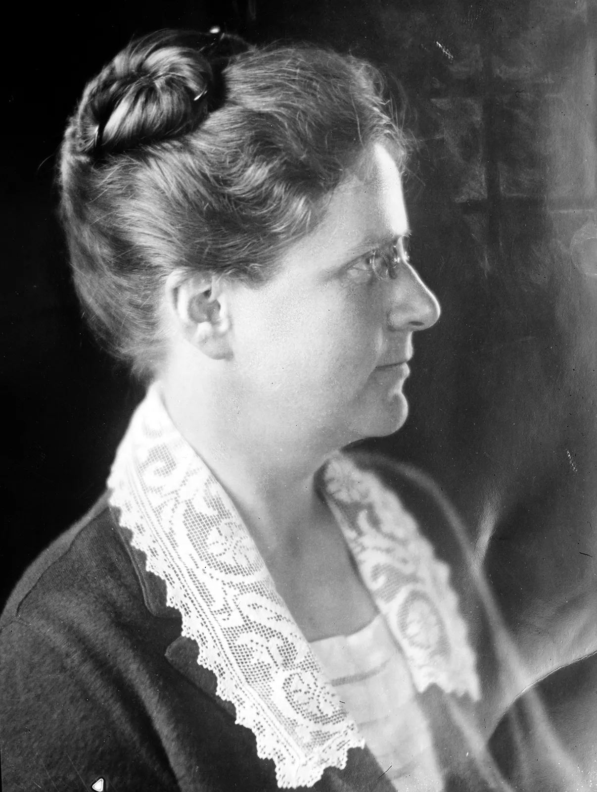
I uploaded this picture of Justice Florence Allen and entered the prompt “meets bigfoot”
Notes:
Can upload a photo and

Slide 8
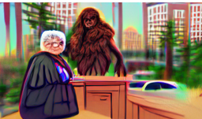

Slide 9
Public Law
US
Code
Statutes at
Large
https://pixray.gob.io/
Notes:
Generated by Pixray, which has a lot of settings to play with. I used text boxes and the Colors from Image https://html-color-codes.info/colors-from-image/ to make this. Use for class slides. Can also use images to make a record for a research or writing problem.

Slide 10
Today at Noon: Fist Fight in the Law Library!
Notes:
https://deepai.org/machine-learning-model/text2img

Slide 11
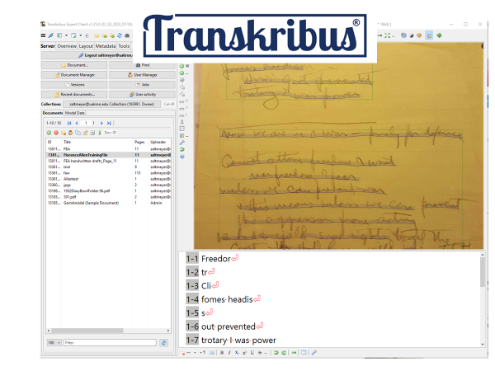
Free?

Slide 12
Transkribus Lite
No download, use in browser
Pick a Public AI Model
Transkribus generally
Free up to 500 handwritten pages, 3,000 printed
Can apply for scholarship
Processing time is a lot shorter now

Slide 13
Publicly Available Models
About 50, More being added
https://readcoop.eu/transkribus/public-models/

Slide 14
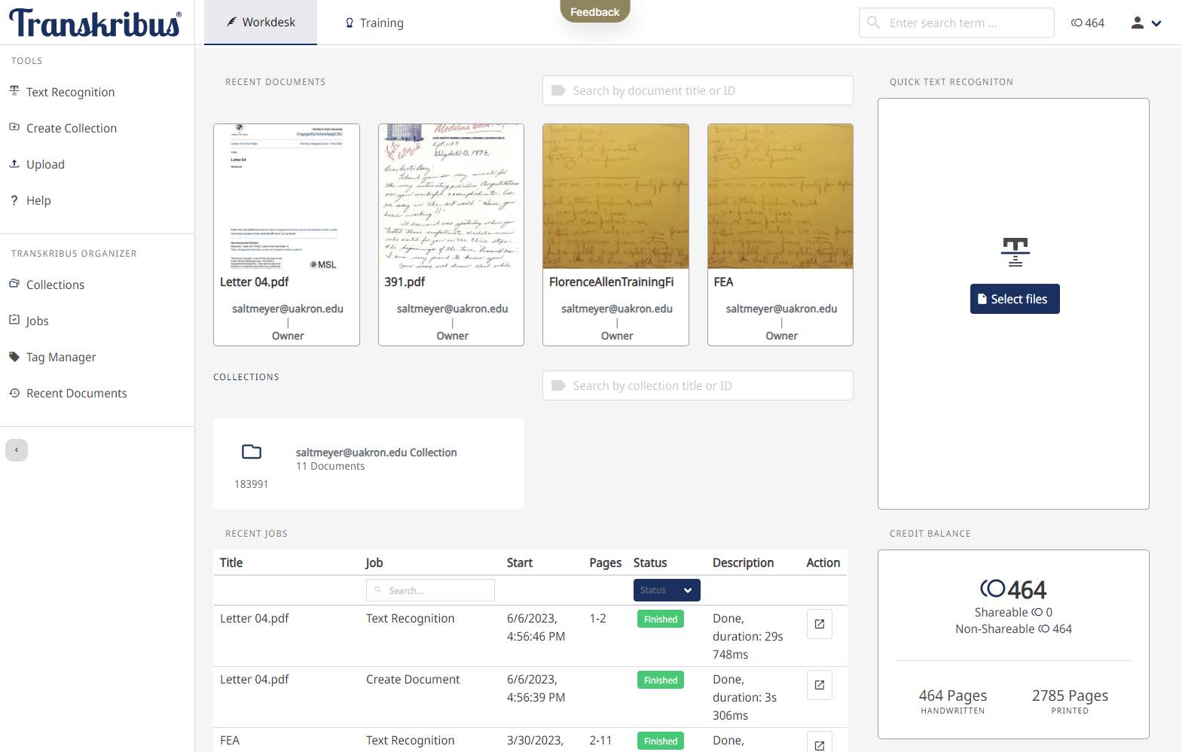
Notes:
Free sign up
500 pages for free
Can apply for scholarship https://readcoop.eu/transkribus/scholarship/

Slide 15
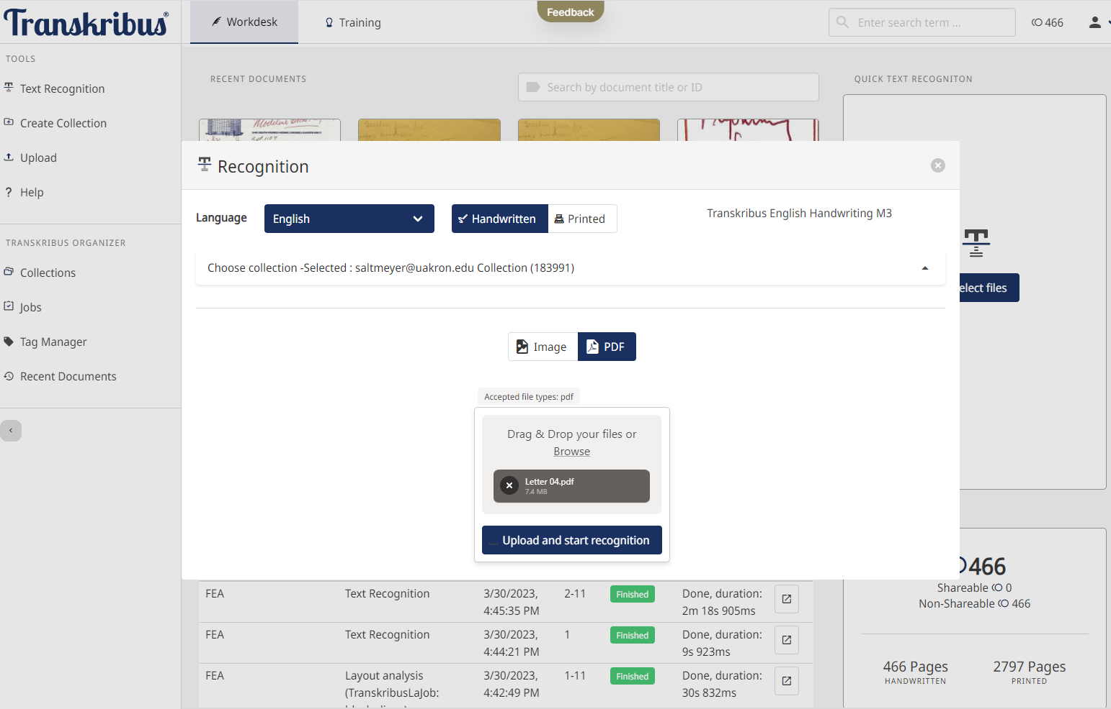
Notes:
Upload image or pdf to start recognition. Pick language and whether printed or handwriting

Slide 16
Notes:
Transkribus Lite. Text is From Sam Shepard Digital Exhibit. Did pretty well. “She cam shaft”

Slide 17
Florence Allen Diary results not good with Lite
Need to make customized model
Notes:
Florence Allen diary pages, transcribed using Transkribus Lite. Try custom model and download software

Slide 18
AI: How does this modern miracle work?
Generative AI platforms are trained on data lakes and question snippets — billions of parameters that are constructed by software processing huge archives of images and text. The AI platforms recover patterns and relationships, which they then use to create rules, and then make judgments and predictions, when responding to a prompt.
Generative AI Has an Intellectual Property Problem by Gil Appel, Juliana Neelbauer, and David A. Schweidel, Harvard Business Review, April 07, 2023

Slide 19
How do you train AI to correctly perceive information and make accurate decisions?
Gather pool of high-quality data
Let AI make decisions on training data. Adjust AI, but do not overfit
3. Test with a new set of data & account for new variables
Notes:
https://www.telusinternational.com/insights/ai-data/article/how-to-train-ai
Overfit means tying to closely to the sample data – won’t be able to work with new data

Slide 20
Custom Text recognition model: 1. Prepare training data
25 -75 pages. On higher end for handwritten
Use publicly available base model to correct data
Segment document into lines
Make corrections to the transcription & save document as “ground truth”
Notes:
https://readcoop.eu/transkribus/video/training-a-handwritten-text-recognition-model-2/ - older video
https://www.youtube.com/watch?v=M7LdrlKoZzk
https://readcoop.eu/transkribus/howto/use-transkribus-in-10-steps/

Slide 21
2. Train the text recognition model
Add metadata - name of model, language, time span of documents
Select pages included as training data
Most go into training set, but save a small amount 2-10% as validation set
When done, get email with error rate. If <10% model is useful

Slide 22
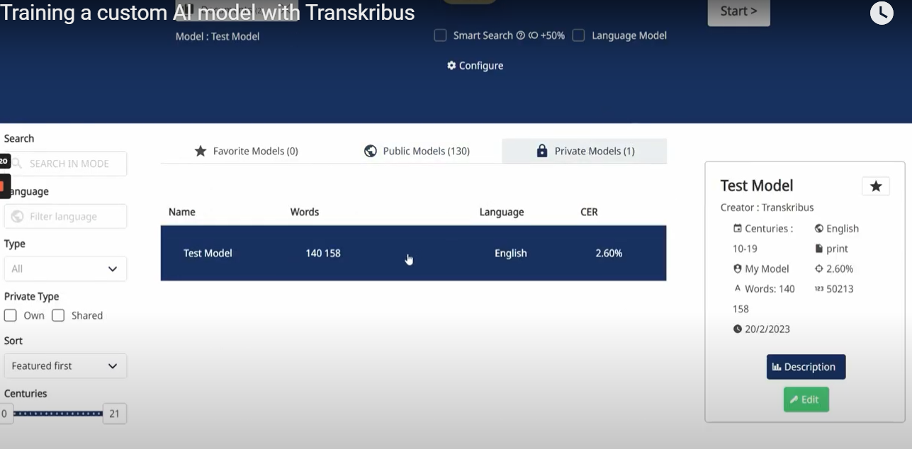
3. Use model to transcribe documents
Select from Private Models

Slide 23
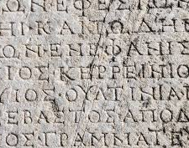
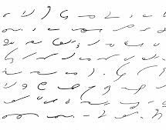
Florence Allen Diaries
From 1910s – 1940s
Not the best quality
Part shorthand stenography
Part Greek

Slide 24
Other handwriting recognition apps
https://www.businessnewsdaily.com/10467-best-handwriting-recognition-apps.html
- MS Onenote, etc.

Slide 25
Translation Software incorporating AI
Google Translate – use Chrome extension to translate webpages. Can also enter text. Free.
DeepL – growing in popularity, “most accurate”. Limited free plan.
Use AI to verify a human’s translation
Book chapter -The Artificial Intelligence in International Law https://link.springer.com/chapter/10.1007/978-981-19-7967-5_11
Notes:
https://www.unite.ai/best-ai-translation-software-tools/
The Artificial Intelligence in International Law, Young-Yik Rhim and KyungBae Park, part of a book Revoluntionary Approach to International Law
https://link.springer.com/chapter/10.1007/978-981-19-7967-5_11
https://translatepress.com/deepl-translator-review/

Slide 26
Personalized Learning
Generally
Cognii – personalized tutoring conversations (chatbots), immediate scoring and feedback on written answers to open-response questions. Not free.
Law School
Chat GPT for immediate feedback for student writing
Spaced Repetition – not free
Grammarly – free version
Notes:
https://www.unite.ai/10-best-ai-tools-for-education/
https://hbr.org/2019/10/how-ai-and-data-could-personalize-higher-education
https://www.ccdaily.com/2023/04/how-will-ai-impact-the-future-of-the-lms/
Coming soon to an LMS near you…
Embedded ChatGPT-like tools for instructors to create quiz questions or lesson plans
Embedded AI chatbots
Personalized learning paths
Better data collection on learners to find ideal content

Slide 27
Cognii

Slide 28
Coming soon to an LMS near you…
Embedded ChatGPT-like tools for instructors to create quiz questions or lesson plans
Embedded AI chatbots
Personalized learning paths
Better data collection on learners to find ideal content

Slide 29
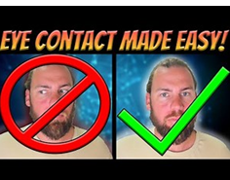
Eye Contact AI for Zoom- Gaze Redirect
https://www.youtube.com/watch?v=LqiFEhnnA9I
https://github.com/HzDmS/gaze_redirection
Notes:
https://www.youtube.com/watch?v=LqiFEhnnA9I

Slide 30
Questions?

